Slide 1

Machine Learning Using Python & Spark
Adarsh raj, a21001

Slide 2
Contents
Problem statement | Data Analysis | modelling | Results
Why we need to solve it? | What does the data look like? | Using Linear Regression ML model | Comparison
What will we gain by solving it? | What are we going to do with the data? | Using all columns | Did the end justify the means?
Okay great, how to solve it? | Analysis & Exploration | Using all non-highly correlated columns

Slide 3
Problem Statement --Why we need to solve it?
So, FIFA belongs to a very popular e-Sports game segment and there are lots of virtual tournaments that are held throughout the world which involves a large prize pool
e-Sports player face a lot of difficulty while choosing the kind of players they would want for their Ultimate team event online as that involves lot of research and selecting player which suits their respective needs.

Slide 4
Problem Statement --What will we gain by solving it?
This will help e-Sports players save a lot of time while selecting the kind of players they would want for their team under limited budget but also tick marks most of their requirements
A sense of personal satisfaction. I have been a huge fan of FIFA game and actively play game in career mode and Ultimate team mode wherein earlier I used to waste a lot of time selecting the kind of players I would need for myself. Say, no more, I got the model for myself now!

Slide 5
Problem Statement --Okay great, how to solve it?
We will be using Spark & Python in Google Colab environment to solve our problem at stake here.
Approach we will be following –
Initiating Spark environment and loading required libraries & modules when needed
Loading & Understanding the data
Exploratory Data analysis
Using ML model to get the desired results

Slide 6
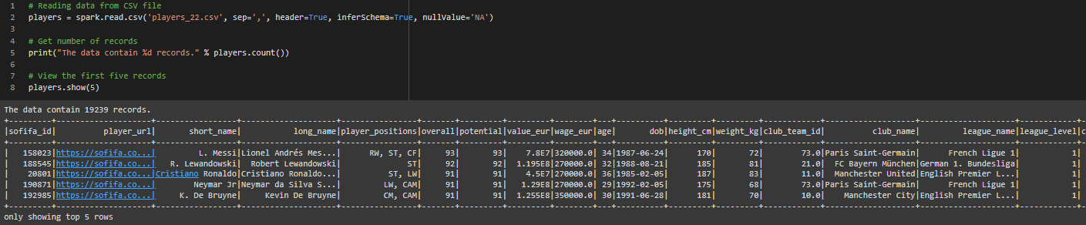
Data --What does the data look like?
The original dataset structure is as below. Note that there are 19239 records and 100+ columns.

Slide 7
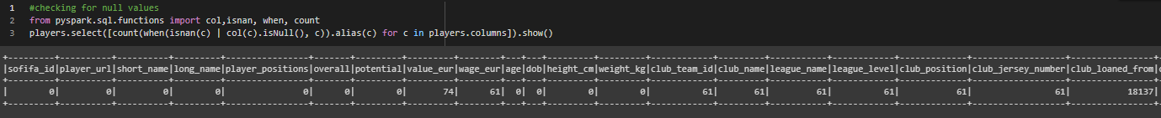
Data --What are we going to do with the data?
Null value check Using PySpark’s library functions, we check for any NULL or NA values in the dataset and accordingly those rows/columns are dropped depending on the requirement
We see that in some columns there are lot of missing values whereas in some, they are very little

Slide 8
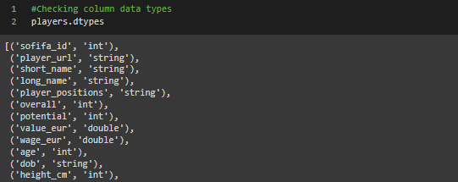
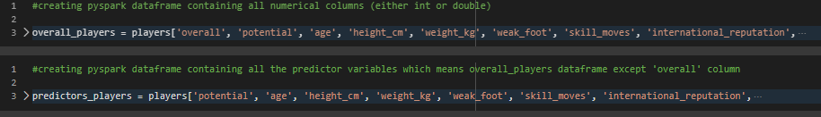
Checking player columns data type
Based on the above result, we will separate out the “int” & “double” columns which are not having any NULL or NA values, we will be needing for our analysis and modelling purpose.
Above we have created 2 DFs – “overall_players” which contains all numeric columns and “predictors_players” which contains all the numeric predictor variables.

Slide 9
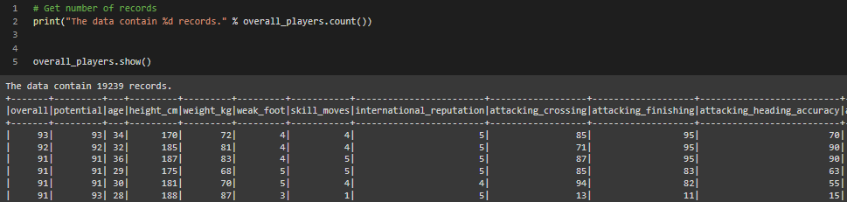
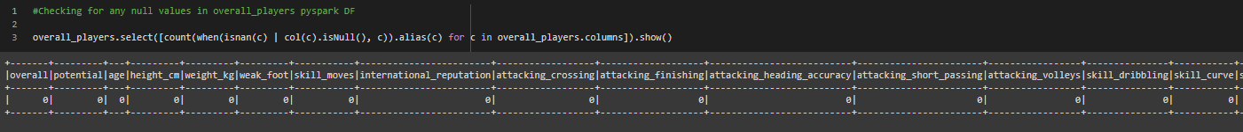
Checking the newly created “overall_players” data frame
Null value check in the new data frame. We see that there are no NULL or NA values

Slide 10
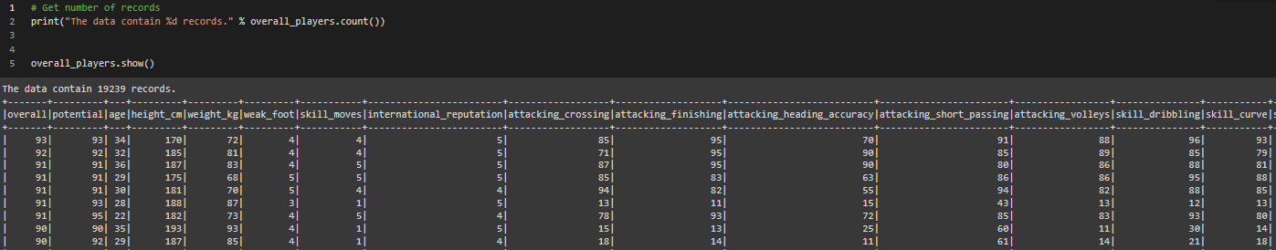
Data --Analysis & Exploration
This is what our “overall_players” pyspark DF looks like now. Note that, we still have 19239 records with 42 columns. Also, there are no NULL or NA values in “overall_players” data frame.

Slide 11
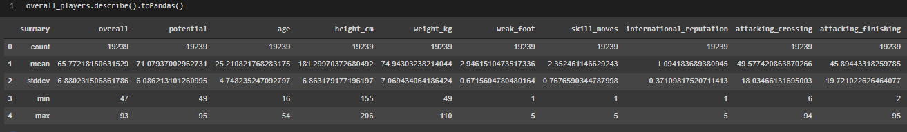
Using .describe() function to check for statistical parameters of all the numeric columns.
We see that most of the data lies between 0 – 99 except for few like height, weight, international reputation etc.
None of the data needs scaling or normalization as the range is pretty similar for all of them

Slide 12


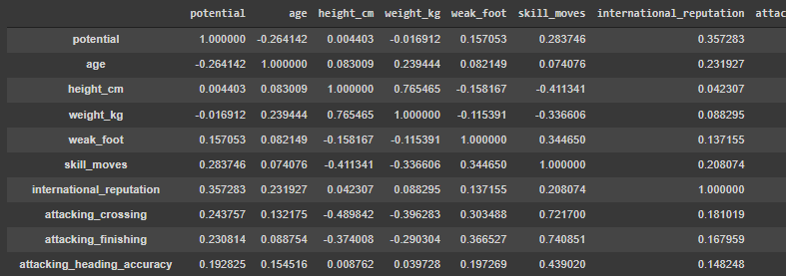
Correlation matrix
First, we must create an RDD from our “overall_players” before using statistics from pyspark’s MLlib to create a correlation matrix and then use basic pandas' operation to have a data frame having same rows and columns and correlation value.
Pandas DF having correlation values

Slide 13
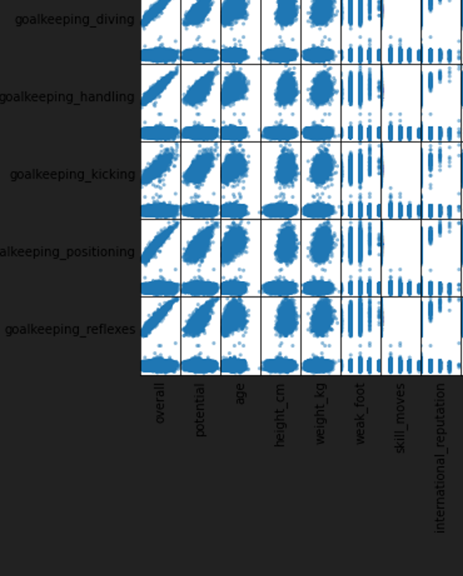
Scatter matrix chart of all numeric features (only few are shown here as original image is too large)

Slide 14
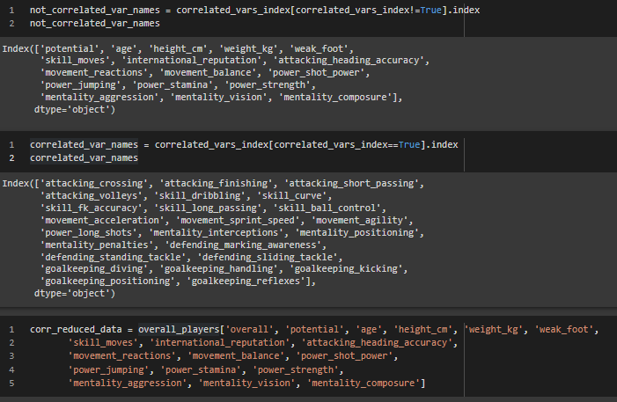
Getting highly correlated columns
Above we are getting the list of highly correlated columns (abs correlation > 0.8 and < 1) and subsequently list of not highly correlated columns Also, creating “corr_reduced_data” DF which stores all non highly correlated columns for our use in modelling purpose later on

Slide 15
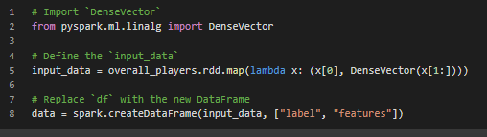
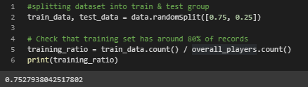
Modelling --Linear Regression
As the target column is a continuous variable, we will be using linear regression. Firstly, by using all the columns and then later using the not highly correlated columns to see what kind of performance we have without the correlated columns.
Splitting dataset into label & features
Splitting into train & test and verifying size

Slide 16
Modelling --Using all columns
As mentioned, all the columns are used for modelling and prediction of ‘overall’ column. Results –
Above are the adjusted R2 & RMSE results of the trained model. We see –
Model does not have any underfitting or overfitting problem as the adjusted R2 & RMSE values are same across the entire dataset
Model can explain 90% of the variance in “overall” column with the help of all the columns used which makes it quite an impressive model
 | Train Data | Test Data | Entire Data
Adjusted R2 | 0.904 | 0.907 | 0.905
RMSE | 2.121 | 2.096 | 2.115

Slide 17
Modelling --Using all non-highly correlated columns
As mentioned, all the columns which are not highly correlated are used for modelling and prediction of ‘overall’ column. Results –
Above are the adjusted R2 & RMSE results of the trained model. We see –
Model does not have any underfitting or overfitting problem as the adjusted R2 & RMSE values are same across the entire dataset
Model can explain ~90% of the variance in “overall” column, which is the same as previous model, with the help of much lesser columns which makes it a brilliant model
 | Train Data | Test Data | Entire Data
Adjusted R2 | 0.894 | 0.891 | 0.893
RMSE | 2.241 | 2.266 | 2.247

Slide 18
Results --Comparison
Below is the comparison of linear model trained on “all columns” and on “uncorrelated” columns. We are only taking summary results for the entire dataset (and not train or test).
Above are the adjusted R2 & RMSE results of the trained models on the two datasets. Inferences –
Model gives the same result even when so many columns have been removed which means “uncorrelated columns” trained model is better
There is only a slight increase in RMSE but still comparable to the original model
Time taken for modelling will be lessened significantly now
 | Entire Data – “All columns” | Entire Data – “Uncorrelated columns”
Adjusted R2 | 0.905 | 0. 893
RMSE | 2.115 | 2.247

Slide 19
Results --Did the end justify the means?
Basically, we were able to train 2 models with the help of entire and reduced dataset and achieve the same result in both dataset. Inferences & path forward –
As FIFA game is a yearly release, the model can be extended to the latest game edition every year in future or in case of squad update, and we will still be getting quite a splendid result
We should be using the “uncorrelated columns” dataset trained model for modelling and further ML pipeline purpose
So, at the end yes, the end justify the mean as the entire process of weeding out highly correlated columns served us a model performing the same as initial but with lesser compute time and data requirement. It’s a win!

